Slide 1

Enhanced Travel Plan Monitoring Reports Using TRICS
HARRY SUMMERFIELD, TRICS CONSORTIUM LIMITED
Notes:
In this presentation, I am going to present the recently updated version of the TRICS Travel Plan Monitoring Report (TPMR) facility, including a couple of examples of what you can expect to see when using this feature. Some TRICS users may not be fully aware of the availability of this feature, so today is a good time to present it and to explain its functions.

Slide 2

WHAT IS THE TRICS TPMR FACILITY
Information provided in the TPMR output is split into the following:
Information regarding the site’s location, development and parking details
A summary of the site travel plan features
User-defined trip rate calculations and mode split pie charts, plus a vehicle occupancy chart.
The TPMR Provides a quick and easy method for users to produce TPMR report, including annotated key information on an individual SAM survey.
It is designed to provide a document that even those who aren’t familiar with TRICS can easily read and understand.
Notes:
The idea of the TRICS TPMR facility, when it was first put together, was to provide a quick and easy method by which TRICS users could produce Travel Plan Monitoring Reports, to include key information on individual Standard Assessment Methodology (SAM) surveys, and with automated explanatory commentary provided throughout the report. The commentary within the report is designed so that even those who aren’t familiar with TRICS can read through the document and find it easy to understand.
The information provided within the report is broken down into the 3 following sections.
1. Information regarding the site’s location, development and parking.
2. A summary of the site’s travel plan features.
3. User-defined trip rate calculations and mode split pie charts, plus a vehicle occupancy chart.

Slide 3

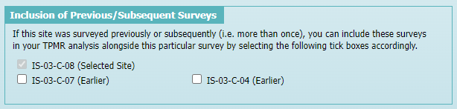
WHAT IS THE TRICS TPMR FACILITY
It provides direct data comparisons for SAM sites that have been surveyed more than once (which is quite often).
The TPMR does not provide any suggestions of why there may have been changes over time, providing the hard data allowing practitioners to exercise their professional judgement.
Notes:
The TPMR facility also allows users to directly compare data at a site that has been surveyed on more than one occasion (which is quite common for SAM surveys), so that data over time can be assessed.
For example, here you can see a block of privately owned flats has been surveyed on three occasions, meaning we can select the site reference codes for the development that we wish to compare.
However, it should be noted that the reports generated by the TPMR facility do not provide any suggestions as to why there may have been changes over time. Instead, TRICS provides the hard data which then allows practitioners to exercise their own professional judgement.

Slide 4
THE UPDATED TPMR FACILITY
Following a major update to the Travel Plan data section in 2022 it was necessary to also update and improve the TPMR facility.
This work took place this year and went live in TRICS version 7.10.3 (September 2023).
This update and improvement needed to be compatible with all SAM Surveys input before 2023, as well as all the surveys undertaken from 2023 onwards.
It was also necessary to make it compatible with the fact that the TRICS Travel Plan data section had been split between residential and non-residential development types.
Notes:
The TPMR facility was first introduced some years ago and following a major update to the TRICS Travel Plan data section in 2022 it became necessary to improve it. It was also well due for an improvement and update anyway, so we took the opportunity to undertake this work to complete the greater update of the SAM part of the TRICS database. This work took place this year, and the updated facility went live in TRICS version 7.10.3 in September 2023. We needed to make the update compatible with SAM surveys that were input before 2023 as well as all surveys undertaken from 2023 onwards, and we also needed to bear in mind that the revised Travel Plan data section in TRICS now shows some different information for residential sites when compared to non-residential sites.

Slide 5
UPDATED TPMR FACILITY - IMPROVEMENTS
A complete re-write of all automated explanatory commentary, expanding the previous version to make the report more descriptive with improved context.
An improved layout and presentation of the report.
The addition of further site, development and parking data in reports.
Data showing increases of occupied dwellings, site area and on-site parking for sites surveyed on more than one occasion is now shown in reports.
An increase in the amount of information shown about a site’s travel plan, broken down into sub-categories which are named depending on whether the site was surveyed before 2023 or from 2023 onwards.
Notes:
So here is a quick summary of the main improvements that have been made to the TPMR facility for this update. Firstly, there has been a complete re-write of all automated explanatory commentary, expanding on the previous version of the facility to make the report clearer and more descriptive with improved context. There is also an improved layout and presentation of the report. Then we have the inclusion of additional site, development and parking data in the reports to make them more comprehensive. Data has also been introduced which shows any increases in occupied dwellings, site area and on-site parking for sites that have been surveyed on more than one occasion. For example, this provides extra context on the growth of residential developments over time, as many residential SAM surveys take place through phased stages of development construction. Finally, there is an increase in the amount of information shown about the site’s travel plan, broken down into sub-categories which are named depending on whether the site was surveyed before 2023 or from 2023 onwards.

Slide 6
HOW TO ACCESS THE TPMR FACILITY
When viewing an individual SAM site in TRICS, select the Travel Plan data section.
Then, select the Travel Plan Monitoring Report button.
The TPMR facility is then accessed, and its various sub-sections become available.
Notes:
Here is how you can access the TPMR facility. When viewing an individual SAM site, you should select the Travel Plan button within the Site Record Pages. This will present you with the various Travel Plan sub-sections of information. You will then see there is a Travel Plan Monitoring Report button at the bottom of these, so if you click on that you will access the TPMR facility. As you can see, it also has some sub-sections within it, which I will explain.

Slide 7
EXAMPLES OF TPMR USE
Notes:
We are now going to look at two different examples of different TRICS land uses side-by-side and what you will see when using the TPMR feature in both cases. One example is for a residential site and the other is for a non-residential site, in this case being a hotel.

Slide 8
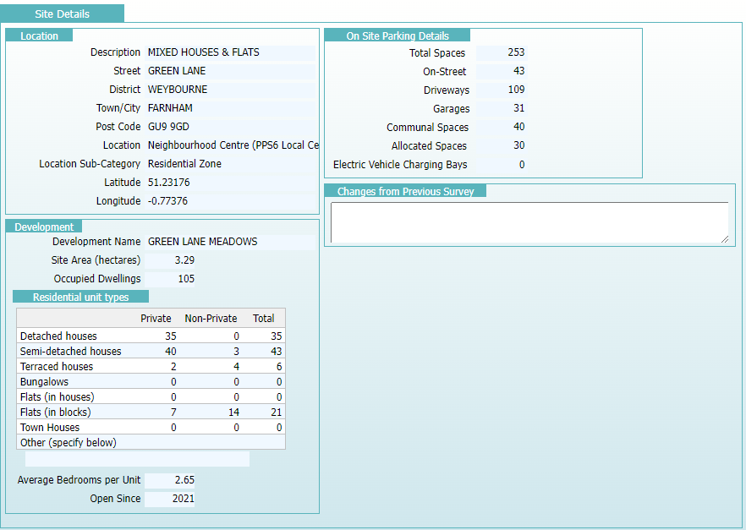
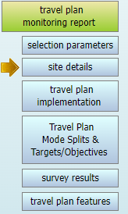
SITE DETAILS (RESIDENTIAL LAND USE)
Notes:
I will take you through both examples. You can see that on the left of this screen are the buttons for the six sub-sections of the TPMR facility. Let’s start by looking at the Site Details sub-section. This is a quick summary of key information on the residential site’s location, development and on-site parking. As you can see, as this is a residential site, the development section includes a table breaking down the residential unit types of all occupied dwellings at the time of the survey, so we can see the number of detached houses, semi-detached houses, flats, etc, also broken down by privately owned and non-privately owned dwellings. You can also see that on-site parking is broken down by parking space types.

Slide 9
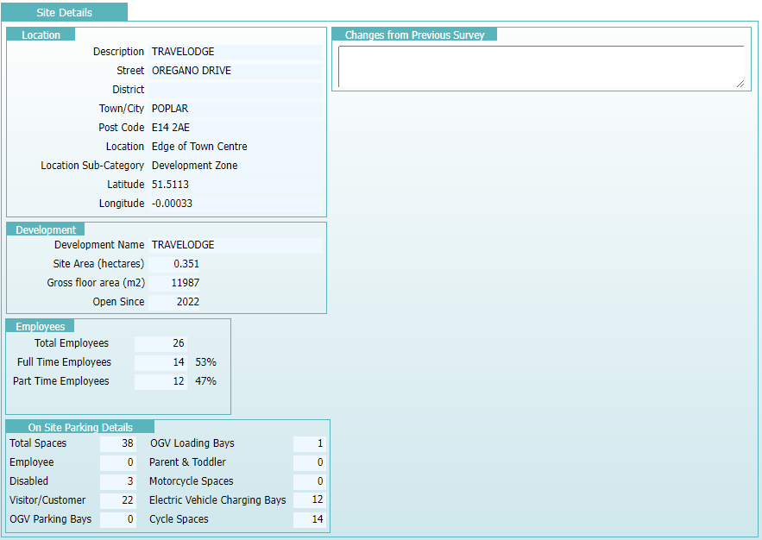
SITE DETAILS (NON-RESIDENTIAL LAND USE)
Notes:
Now here is the Site Details sub-section for a non-residential site (in this case a hotel). The key differences from the residential development are in the development and the parking details information. You can see that instead of stating the different types of residential units we have employee information, and instead of different types of on-site residential parking types such as driveways and garages, we have a non-residential breakdown including employees, customers, OGVs, etc.

Slide 10
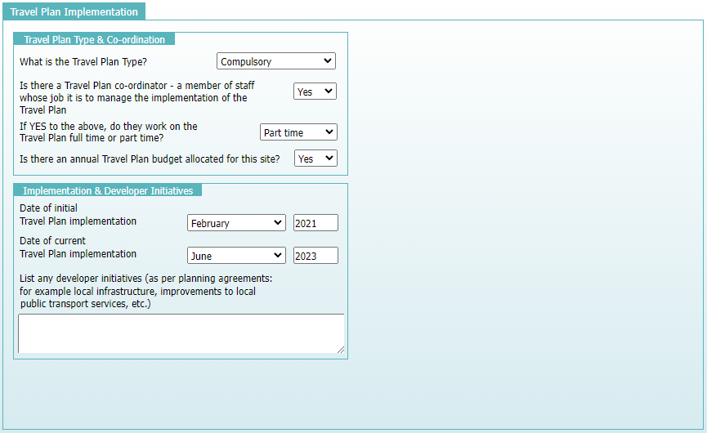
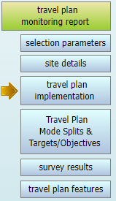
TRAVEL PLAN IMPLEMENTATION
(ALL LAND USES)
Notes:
The Travel Plan Implementation sub-section of the TPMR facility includes information on the type of travel plan at the site and whether there is a Travel Plan Co-ordinator who works on the travel plan’s development and implementation. It also provides information on when the travel plan was implemented and any developer initiatives (as per planning agreements). Note that there are no differences shown for residential sites compared to non-residential sites.

Slide 11
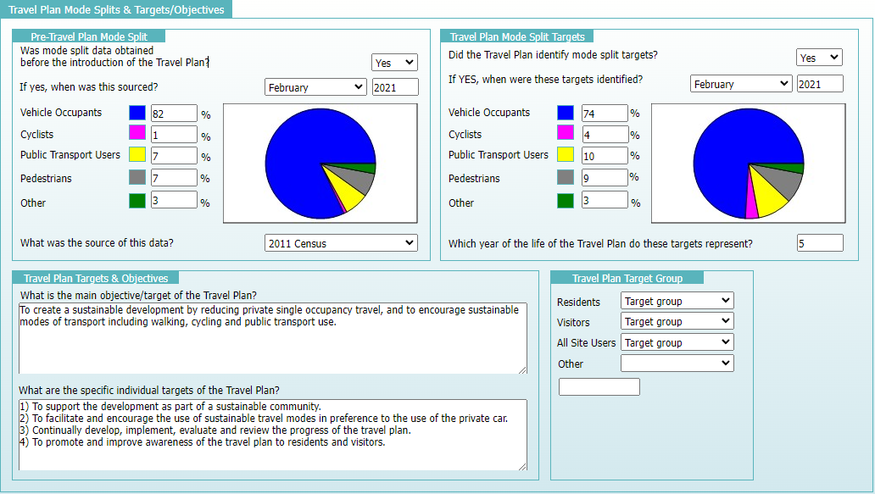
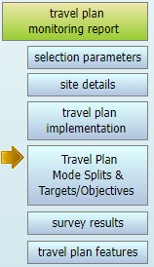
TRAVEL PLAN MODE SPLITS & TARGETS/OBJECTIVES (RESIDENTIAL LAND USE)
Notes:
The Travel Plan Mode Splits & Targets/Objectives sub-section includes information on the pre-travel plan mode splits and travel plan mode split targets, plus the travel plan’s objectives and specific (commented) targets and the travel plan target groups. The difference between residential and non-residential land uses is shown in the travel plan target groups. You can see within the residential target groups in this example that the target groups are split between residents, visitors, all site users and other.

Slide 12
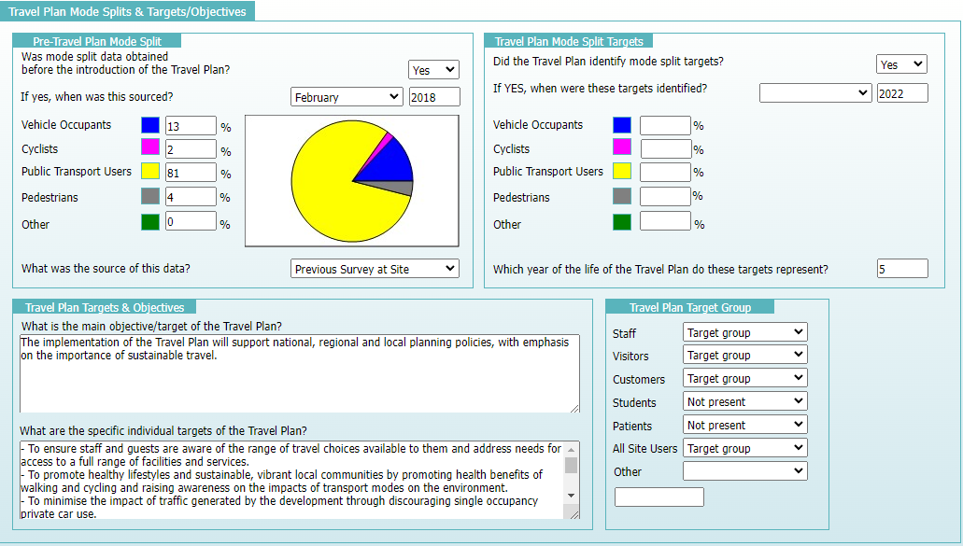
TRAVEL PLAN MODE SPLITS & TARGETS/OBJECTIVES (NON-RESIDENTIAL LAND USES)
Notes:
Whereas if you look at the travel plan target group section for a non-residential site, we see staff, visitors, customers, students, patients, all other site users and others. What target group types are included within a travel plan will vary, depending on the land use type. For instance, in this example of a hotel, we see that staff, visitors and customers are target groups, but if we were to look at a GP surgery you will most likely find patients are a target group, or in a school example, students would be. Note that for SAM surveys undertaken before 2023, all target groups are displayed, whereas now the Travel Plan data section has been split for new surveys between residential and non-residential sites, we now get better context.

Slide 13
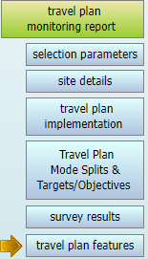
TRAVEL PLAN FEATURES
Summarises all individual travel plan elements along with implementation dates and commentary.
It is broken down into the following categories:
  Cycling
  Incentives (called Financial pre-2023)
  Public Transport
  Marketing Suite/Shuttle Bus (depending on whether the site is residential or non-residential)
Notes:
The Travel Plan Features sub-section is a larger section of information which summarises all individual travel plan elements, providing implementation dates and commentary where available. It is broken down into the following sub-areas: Cycling, Incentives (which is called Financial for all surveys pre-2023), Public Transport, and Marketing Suite or Shuttle Bus (depending on whether the site is residential or non-residential). This section is a replica of the data that is contained within the various sub-sections of the Travel Plan data section for the site, handily placed amongst the other sub-sections to provide good detail and context for users operating the TPMR facility. Due to the amount of information in this sub-section I won’t go into every difference between residential and non-residential sites, but one example is the information shown in the cycling area of this sub-section. For residential sites, the information shown includes whether there is on-site storage for cycles at houses and flats, as well as if there are any cycle routes through or around the site to connect it to local amenities. With non-residential sites, such as the hotel we have been looking at, information regarding the availability of facilities such as showers, lockers and changing rooms is displayed, as well as other information such as events that encourage staff members to cycle into work, etc.

Slide 14
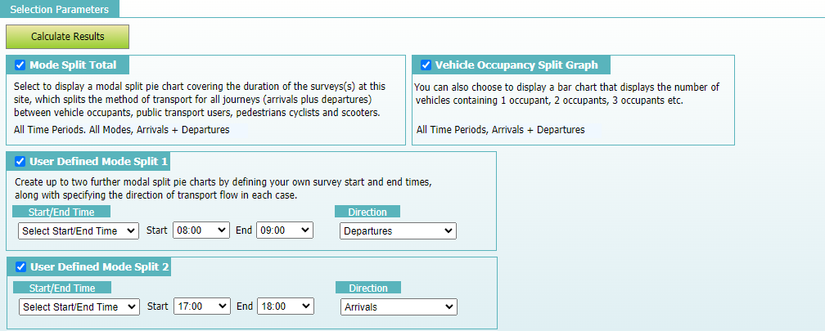
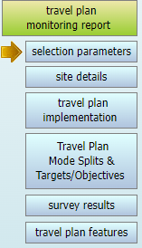


SELECTION PARAMETERS
Notes:
We now move on to the Selection Parameters sub-section, where users can apply their criteria for calculating a series of trip rate results and mode split pie charts, plus the inclusion of the vehicle occupancy split chart and, if applicable, the comparison option for sites that have been surveyed on more than one occasion. Here you can see the first half of the Selection Parameters sub-section. The first selection is the Mode Split Total. Clicking on the tick box for this selection will include a mode split pie chart covering the duration of the survey at the site in both directions combined (arrivals plus departures) across all time periods. Depending on when the survey was undertaken, the mode split pie chart will be split by vehicle occupants (sub-split by single vehicle occupants and multi vehicle occupants), cyclists, scooters (available for surveys undertaken from 2022 onwards), pedestrians and public transport users. Next is the Vehicle Occupancy Split Graph. Clicking on the tick box for this selection will include the graph covering the duration of the survey at the site for both directions combined (arrivals plus departures). This chart will display the number of vehicles with 1 occupant, 2 occupants, 3 occupants etc, up to 7 occupants. Note that this chart is the same that can be accessed for the site on its Vehicle Occupants count screen and will exclude drivers of vehicles picking up/dropping off people at the site. Then we have up to two optional User Defined Mode Splits. In the first set of drop-down options, you can either choose a specific start and end time, use all survey periods, or use the peak (busiest) survey period, and the final selection is the direction of flow. In our example we have a residential site, so we have decided to calculate the departures mode split for the 0800-0900 period and the arrival mode split for the 1700-1800 period.

Slide 15
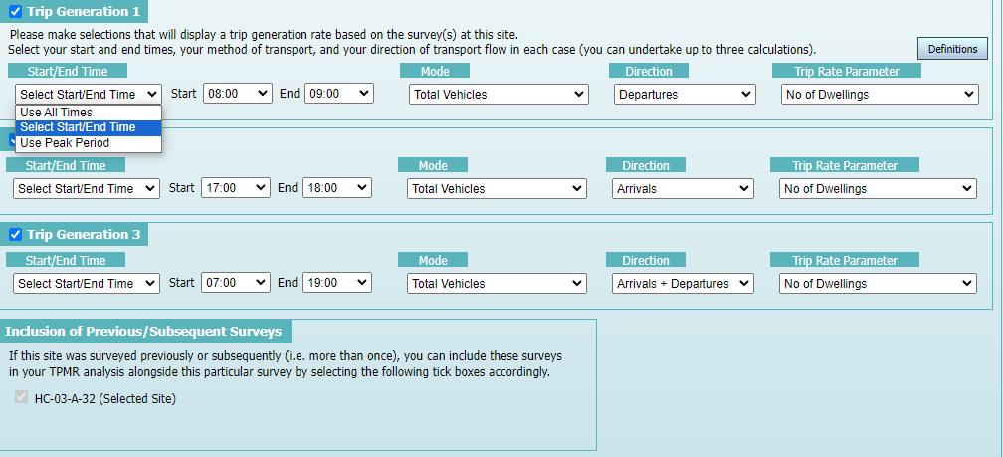
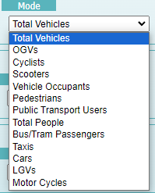

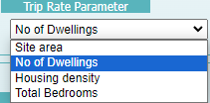
SELECTION PARAMETERS
Notes:
We then have our trip generation selections. These allow the inclusion of up to three user-defined trip rate calculations. Note that the first selection has its tick box ticked by default and initially includes the full survey duration, but for all three selections users can decide the start and end times (or peak periods), count mode, direction of flow and the trip rate calculation parameter to be used. In our example (for a residential site), we have decided to undertake calculations for total vehicle departures during 0800-0900, using the number of dwellings calculation parameter option. We have also decided to calculate arrivals for 1700-1800, and arrivals plus departures for the total survey duration of 0700-1900. On this screen we also have the inclusion of previous/subsequent surveys for comparative purposes. If the selected SAM survey was a re-survey of a previously surveyed site in TRICS, or if it was itself resurveyed by a subsequent count, then there is the option to include the same calculations that have been user-defined for each associated survey. As you can see this site doesn’t have this option as it has only been surveyed once.

Slide 16

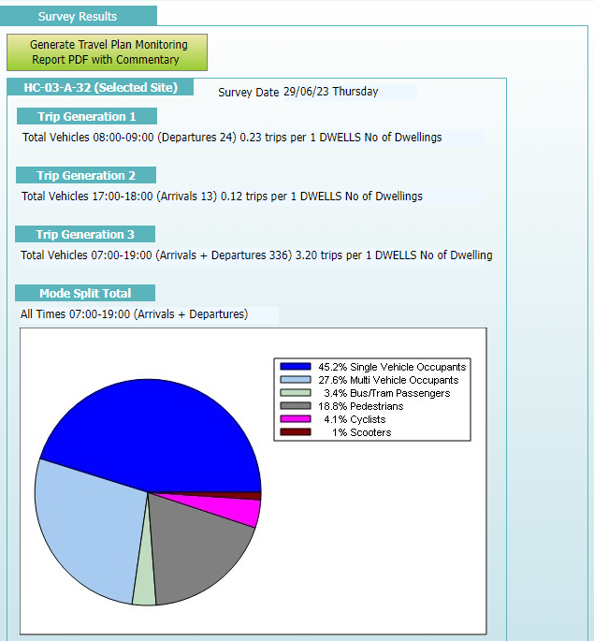
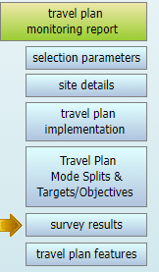
Notes:
At the top of the Selection Parameters screen you will see a Calculate Results button. Once you are happy with your selections, clicking on this button will populate the Survey Results sub-section and will take you to it. In our example you can see the results of the trip rate calculations we selected and the first of our mode split pie charts. You can also see at the top of the Survey Results screen that there is a button called Generate Travel Plan Monitoring Report PDF with Commentary. When you click on this, the Travel Plan Monitoring Report is produced in PDF format. You may also want to add your own paragraph of commentary to the report, and this can be done by selecting the tick box that appears called Add User Comments to Report. Adding your comments and clicking on the OK button will ensure that this text is included in the report.

Slide 17
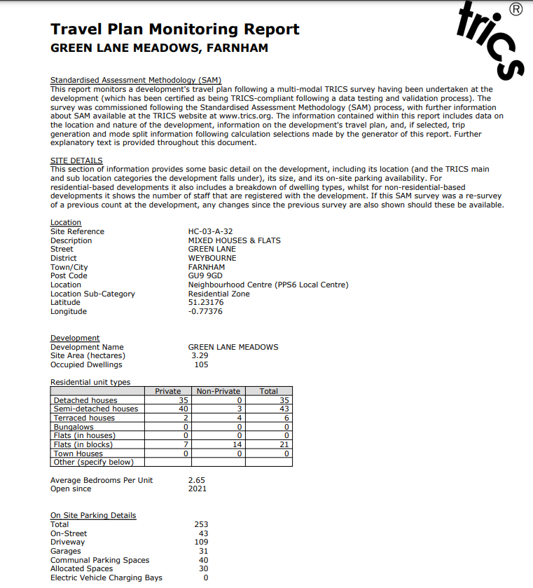
THE REPORT
Automated explanatory commentary assists recipients in understanding the Travel Plan Monitoring Report.
The report consists of the sub-sections that are present in the TPMR facility along with the user-defined selections and results.
Site Details
Notes:
Let’s have a look at the report itself. The report includes the information contained within each of the TPMR sub-sections, along with automated explanatory commentary as introductions to each of the report’s sub-sections, designed to assist recipients of the report in their understanding of it. The report also includes the user-defined selections and results. In this first page we can see the Site Details sub-section, which includes location, development and on-site parking information for our site.

Slide 18
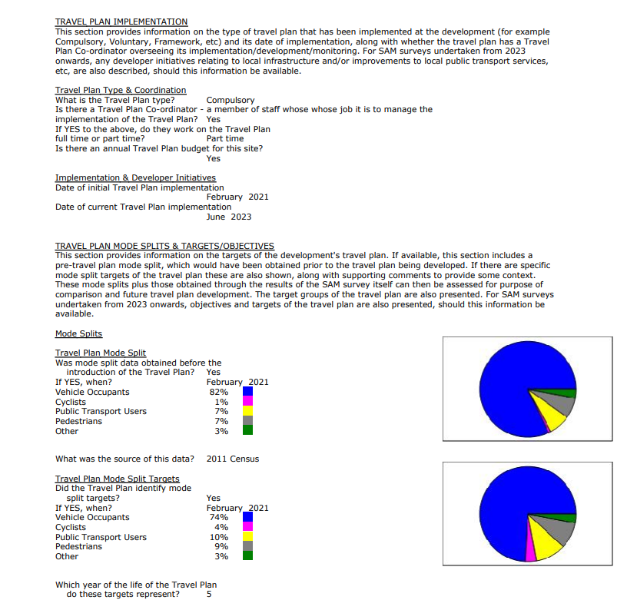
THE REPORT
Travel Plan Implementation
Travel Plan Mode Splits and Targets/Objectives
Notes:
This next page of the report includes the Travel Plan Implementation and Travel Plan Mode Splits & Targets/Objectives sub-sections, and you can again see the automated explanatory providing some good context.

Slide 19
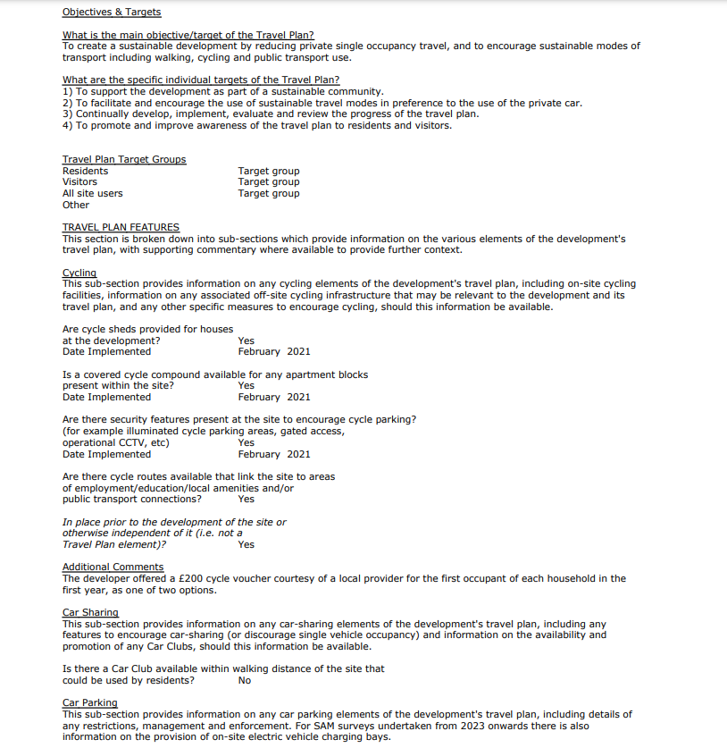
THE REPORT
Final part of the Travel Plan Mode Splits and Targets/Objectives sub-section.
Travel Plan Features.
Notes:
On the next page we have the final part of the Travel Plan Mode Splits and Targets/Objectives sub-section, plus the Travel Plan Features sub-section.

Slide 20
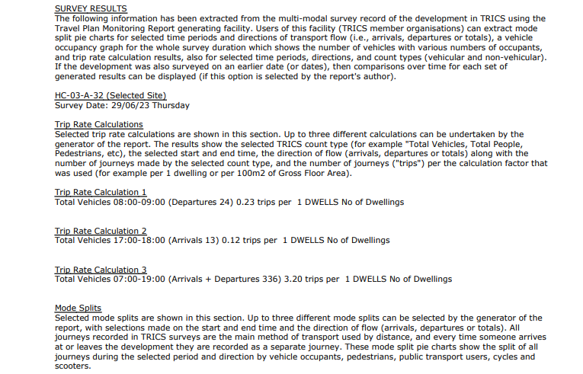
THE REPORT
Survey Results (trip rate calculations)
Notes:
The final part of the report is the Survey Results, which displays the user-defined trip rates and mode split selections and their corresponding results. You can see that there is a fair amount of automated explanatory commentary present, as it is considered very important to provide detail and context of what these results represent.

Slide 21
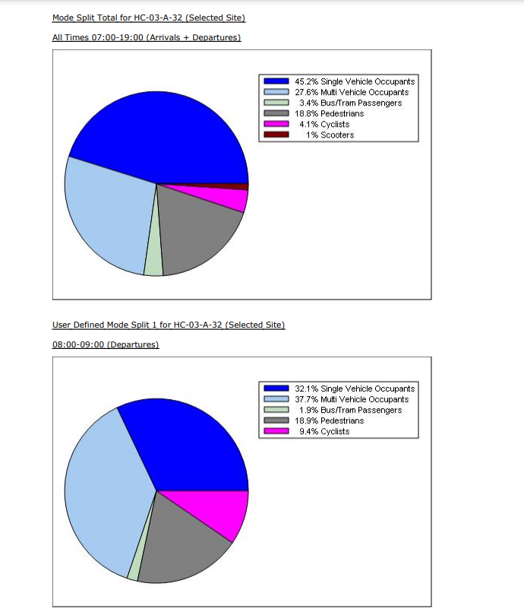
THE REPORT
Survey Results (mode splits)
Notes:
The Survey Results sub-section of the report continues on the next page with the first two of three mode split pie charts. As you can see here, we have the arrivals plus departures pie chart for the 0700-1900 total survey duration shown at the top, and then our first user-defined pie chart for departures during 0800-0900 shown underneath it.

Slide 22
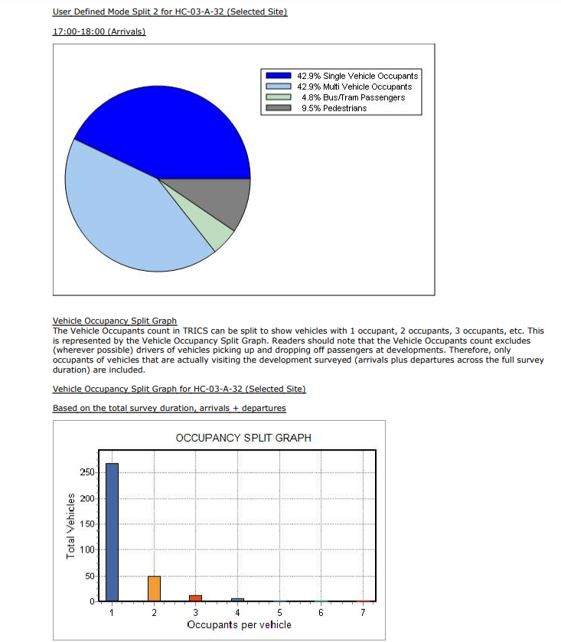
THE REPORT
Survey Results (mode splits and the Vehicle Occupancy Split Graph)
Notes:
Finally, we have our third mode split pie chart, for arrivals during 1700-1800, and this is followed by the vehicle occupancy split graph, which concludes the report.

Slide 23
THE TPMR USER GUIDE DOCUMENT
The Travel Plan Monitoring Report User Guide is available as an explanatory PDF via the highlighted button shown here (at the top of each of the TPMR facility sub-section screens). It provides handy step-by-step guidance that should assist users when using the TPMR facility.
Notes:
Finally, it is important to let everyone know that there is a comprehensive Travel Plan Monitoring Report User Guide available in PDF format. Whenever you view any of the TPMR sub-section screens it is accessible via a button as highlighted on this slide. It is a handy step-by-step guide that should assist users when using the TPMR facility.

